Slide 1
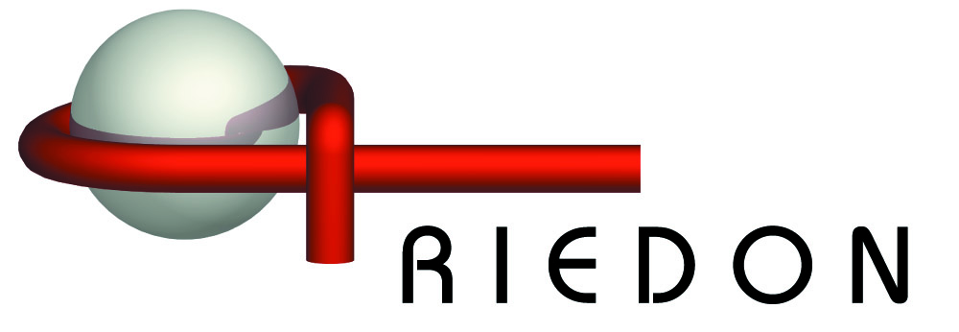
A World of Advanced Resistor Technology
www.riedon.com

Slide 2

Thick Film Chip Resistors
Very High Temperature available
High Value Chip Resistors up to 10 TΩ
Precision High Value Chip Resistors
Power Chip Resistors
Trimmable and Standard Chip Resistors

Slide 3
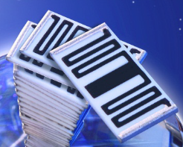
Why Select Riedon Chip Resistors?
High temperature components available for applications up to 300°C
High value resistors with a value range up to 10 Tera-Ohm
Non-magnetic resistors available
High voltage capability of chip resistors up to 6000V
Every value is available
Suitable for lead free soldering as well as silver epoxy attachment
Whisker free surfaces - no Tin whiskering
Suitable for vacuum applications – no organics
Low VCR at extreme high values
Customized solutions

Slide 4
Non-Magnetic Resistors
Riedon chip series CHR, HVC, HVS are absolutely non-magnetic.
These resistors are suitable for the use in strong magnetic fields without restrictions.
The base of this characteristic is a special termination technology, which does not use magnetic Nickel.
Typical Applications: computed tomography (CT) and magnetic resonance imaging (MRI)
Standard-components use Nickel/Tin-terminals therefor have magnetic characteristic.

Slide 5
High Temperature Suitability up to 300°C
HVS, CHR, CBR, HVC are available for high temperature applications up to 300°C
The base of this characteristic is a special termination technology, which does not use Nickel which limits the continuous working temp. to 160°C, or Tin which limits the peak temperature to 230°C).
Limiting factors are the interconnection technology and the substrate material for the unit.
(Standard-components using Nickel/Tin-terminals are restricted to a continuous working temperature of 155°C.)

Slide 6
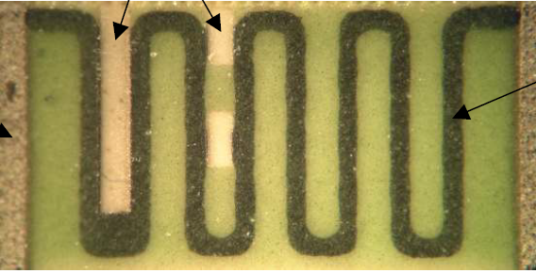
Low VCR-Values
Voltage coefficient of resistance (VCR) is an important characteristic of high voltage thick film resistors. It can be defined as the change in resistance of a component with respect to the voltage applied over a specific voltage range
There are many factors which can influence the VCR: Layout, size, termination material and trimming geometry. Riedon chips are specifically designed to minimize the effects of VCR.
Laser trimming
Resistor Ink
Termination

Slide 7

Suitability for Silver Epoxy Attachment
CHR, CHS, HVS are also suitable for lead free and lead containing soldering as well as for silver epoxy attachment.
The attachment with silver epoxy is highly reliable (at high temperatures too).
The base of this characteristic is the special thick film termination, which does not use Nickel and Tin.
(Standard-components using Nickel/Tin-terminals are not suitable for the use of conductive epoxie)s)

Slide 8
Whiskerfree Surfaces
Thick film terminals (CHR, CHS, CHM) are whisker free:
The surface of the termination does not contain Tin and therefore it can not generate Tin-whiskers. Pure Tin surfaces generate whiskers under certain conditions
This is characteristic which is required in many aerospace applications

Slide 9
High Vacuum Suitability
Riedon chip resistor series are free of outgassing.
Standard-components are coated with a polymeric material which can out gas in vacuum are not suitable for the use of conductive epoxies, carbon film resistors show this behavior too. The resistors do not contain any organic material.

Slide 10

Value Range up to 10 Tera-Ohm
The value range is our core competency: Series HVC and HVS
Riedon delivers high value resistors up to 10 Tera-Ohm. Many other Manufacturers deliver a value range up to 10 MΩ only.

Slide 11
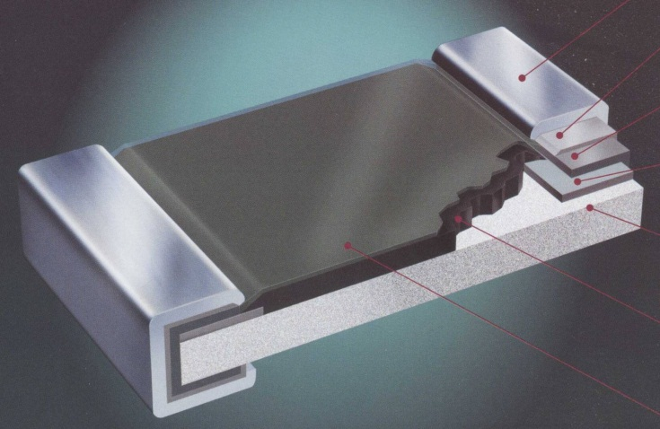
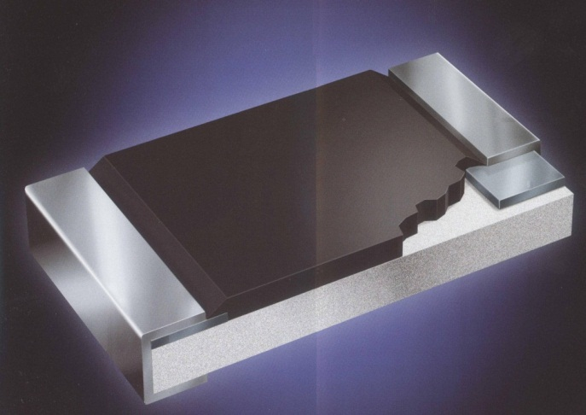
Termination & Construction
Chip resistors with Ni-barrier layer
matte Tin
Chip resistors with thick film termination
Nickel layer
wrap around Silver thick film
wrap around PtAg thick film
inner resistor terminal AgPd
inner resistor terminal AgPd
ceramics substrate
ceramics substrate
resistive layer
resistive layer
glass coating
Series: CRW, CRS
Layers: thick film Silver
Nickel barrier layer (galvanic)
matte Tin (galvanic)
Series: CHR, HVS, HVC
Layers: thick film Platinum/Silver

Slide 12
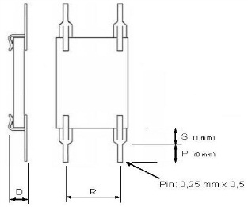
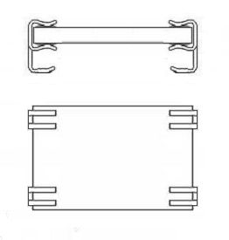
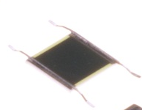
Custom Specific Resistors
Riedon specializes in providing customized solution for non-standard specs.

Slide 13
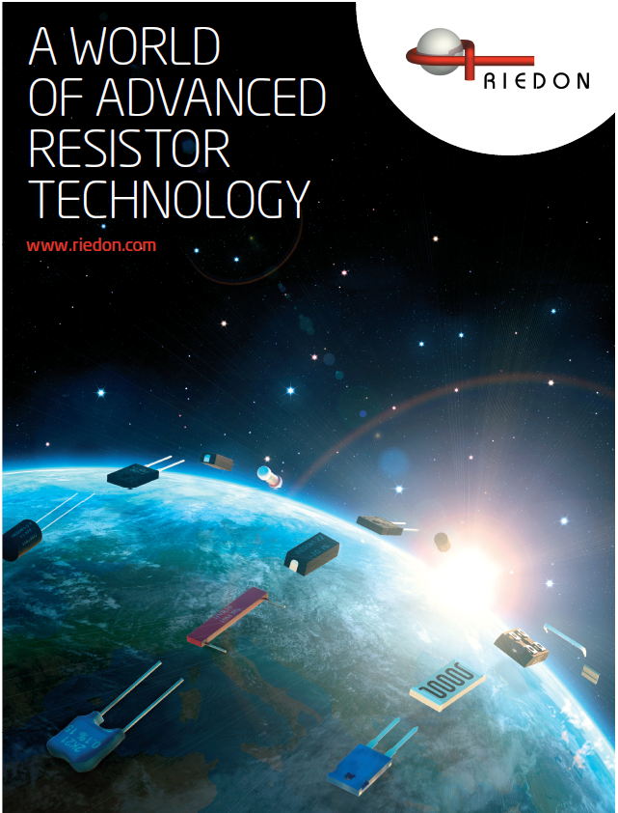
For more information & questions?
  Call us at (626)-284-9901
  Email us Sales@riedon.com
  Tweet us @riedonresistors
  Comment on our Blog: http://riedon.com/blog/

